Slide 1
Group 01:
Group members: Jazlyn Chuah, Zachary Lim, Teo Hwee Leng

Slide 2
Step 1: Identify a data problem to solve
Used data from UCI Machine Learning Repository (publicly available)
What interested us: Boston Housing Prices
Good dataset to use to learn Data Science
Objective: Predicting housing prices in Boston

Slide 3
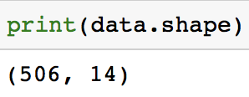
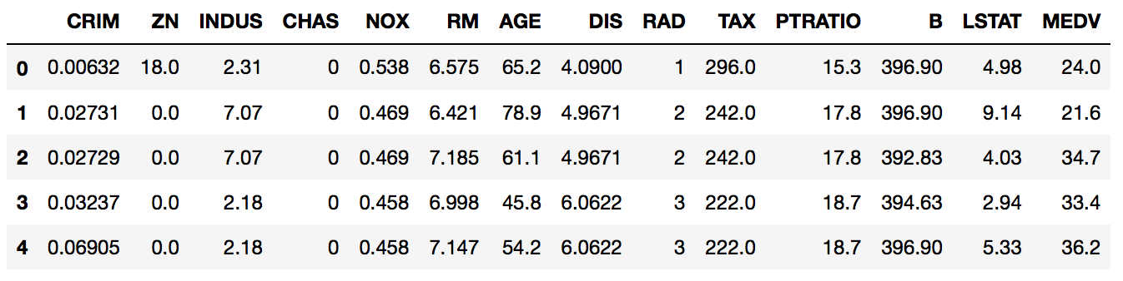
Step 2: Data Acquisition
Used: requests and pandas
Notes:
Requests and pandas module -> help users to obtain the file needed without downloading it in advanced.
After we read the data into the dataframe, we will obtain the table above, which shows that there are 14 columns in our data, which indicates that there are 14 features that we will be able to work with.
When we print the shape of the data, we can also see that there are 506 rows, which means we have 506 data points to work with.

Slide 4
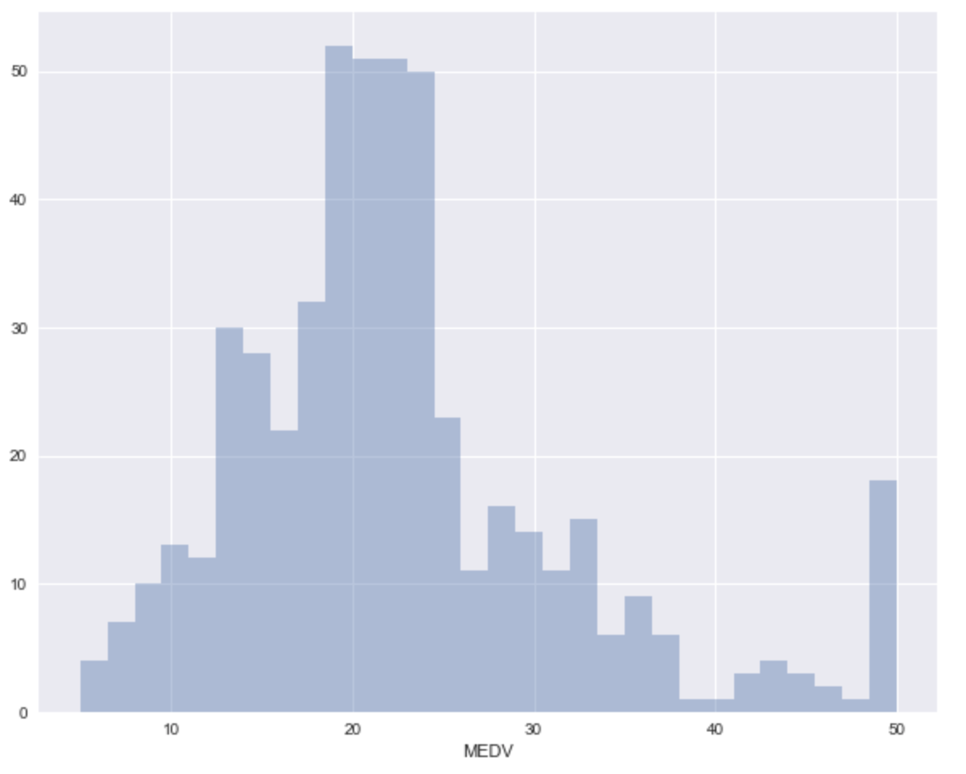
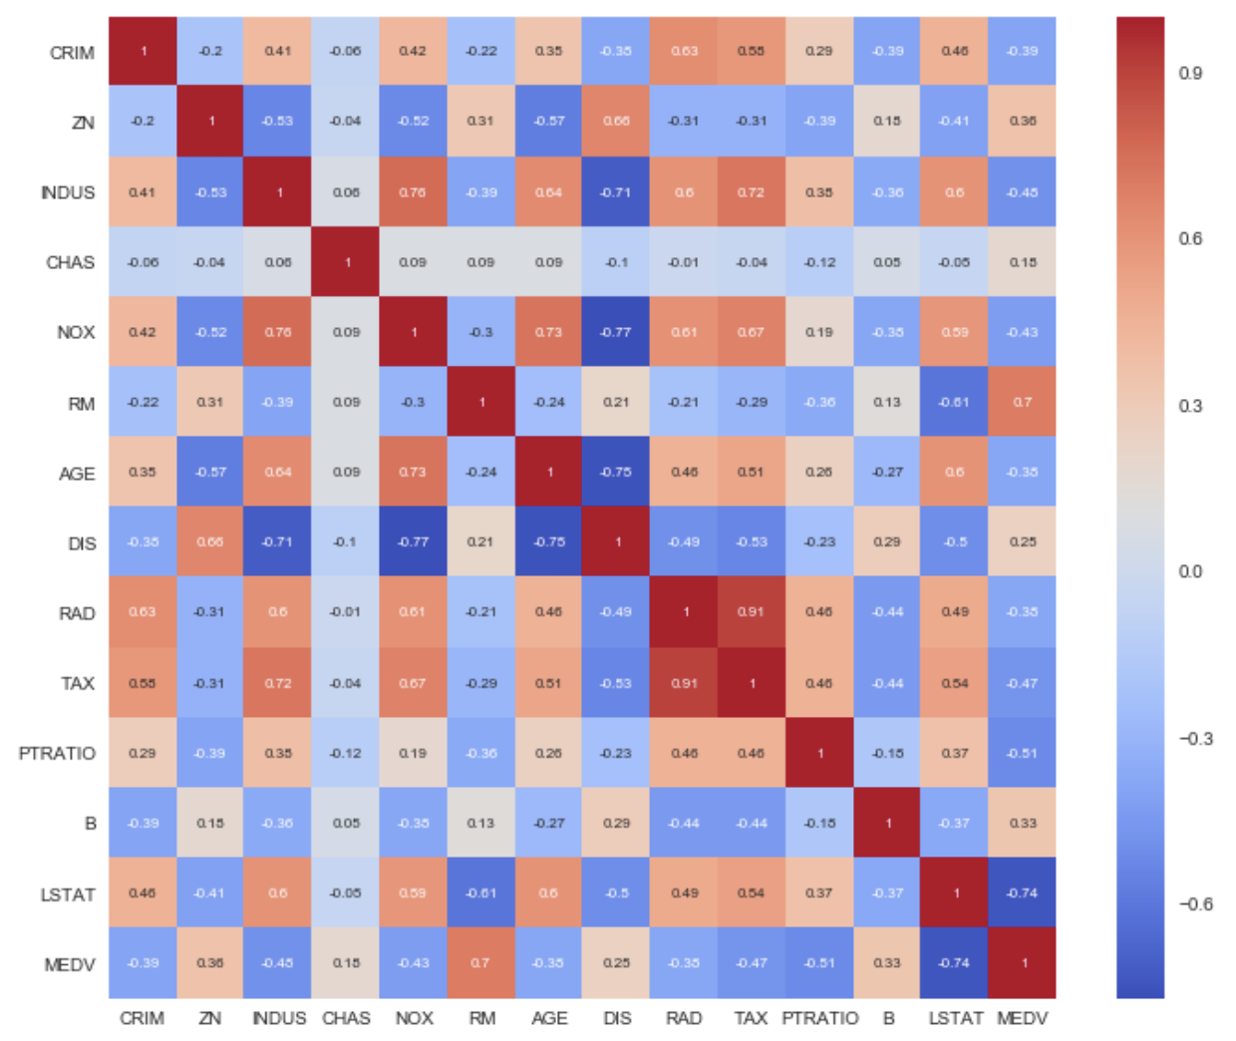
Step 3 & 4: Data exploration & Pre-processing
Check for missing values and remove if any
Analyse target column: ‘MEDV’
Visualisation plots (histogram and heatmap)
Heatmap generated to study correlation between features
Distribution of ‘MEDV’
Notes:
Test 3 steps, everything is (1,1) -> centred.

Slide 5
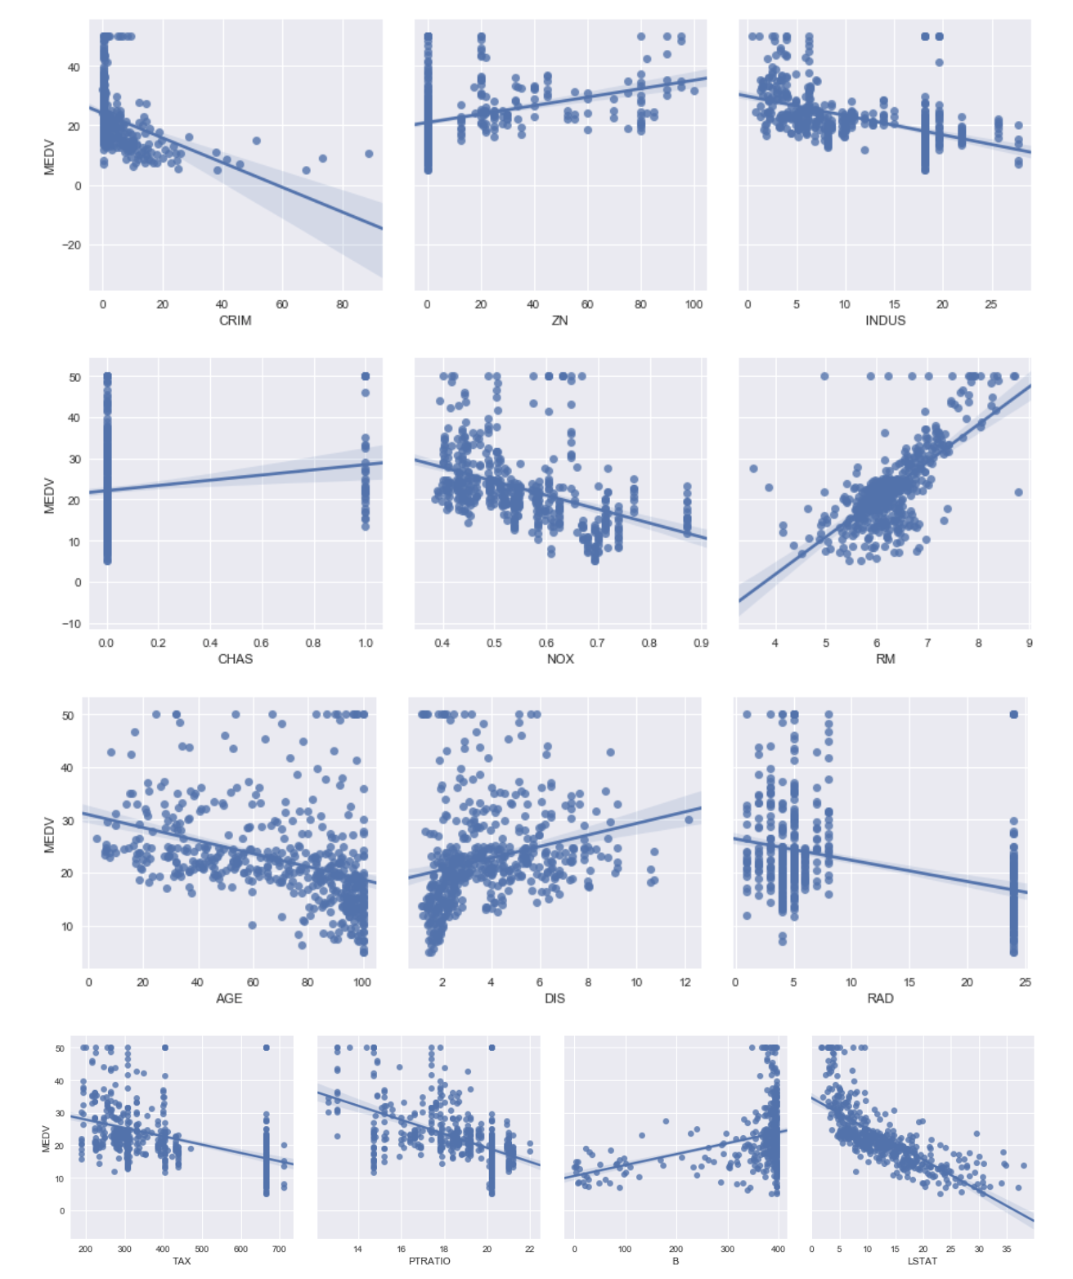
Step 3 & 4: Data exploration & Pre-processing
Pair plots / Scatter plots:
in ‘RM’ ‘MEDV’
in ‘LSTAT’ ‘MEDV’
in ‘PTRATIO ‘MEDV’
Pair plots
Notes:
Test 3 steps, everything is (1,1) -> centred.

Slide 6
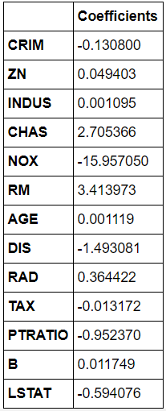
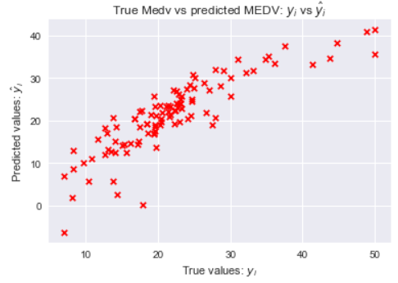
Step 5: Data Analysis
Normal Linear Regression
Calculate MSE,

Slide 7
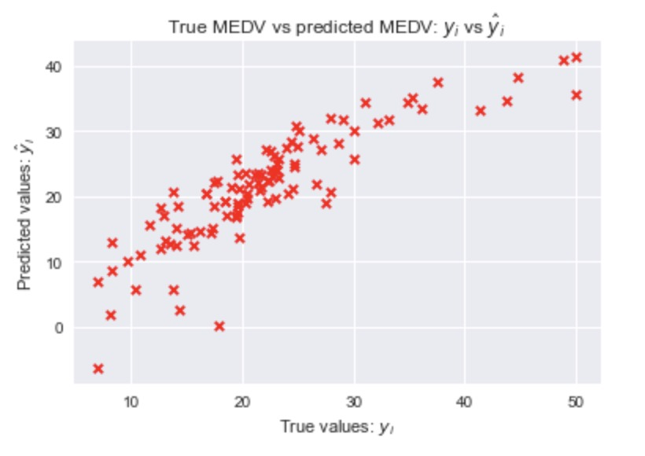
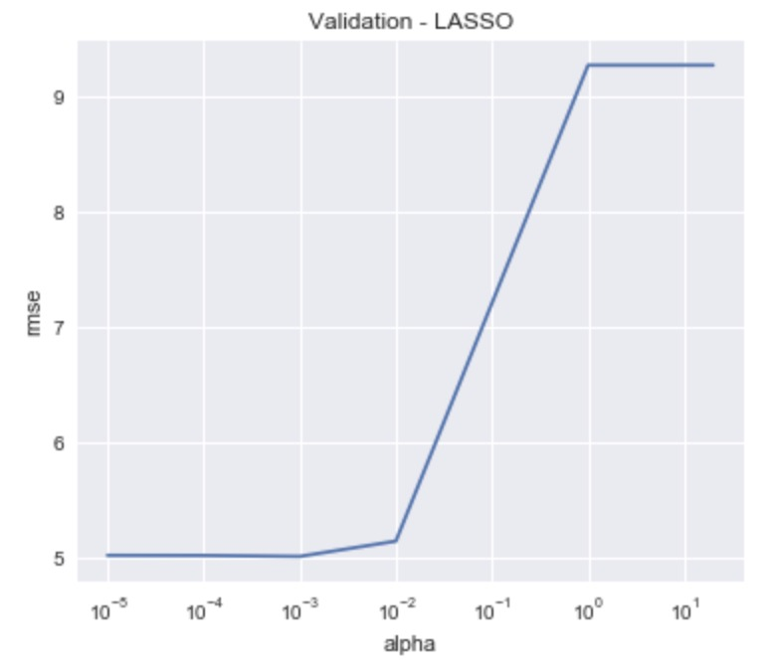
Step 5: Data Analysis
Used sklearn: train_test_split function to split
Set seed value
First: Apply Linear Regression
Next: Apply Feature Selection
Stepwise regression
Perform forward-backward feature selection based on p-value from statsmodels.api.OLS
8 features -> perform linear regression again
Lasso Regression
Main hyperparameter: regularization factor α
Use GridSearchCV to find optimial α (0.001)
Remove features with zero coefficient (‘AGE’)
12 features -> perform linear regression again

Slide 8
Step 5: Data Analysis
Linear Regression | Step-Wise Regression | Lasso Regression
Finding R^2, Adjusted R^2, MSE and RMSE
N.A | Uses a forward-backward feature selection based on p-value from statsmodels.api.OLS to find the desired features which will then use to calculate the accuracy and MSE and RMSE | Performs both regularization and feature selection in order to improve the prediction of our model and then calculate the accuracy and MSE and RMSE.

Slide 9
Step 6: Analysis of results
Linear Regression | Step-Wise Regression | Lasso Regression
r square ≈ 0.733 adjusted r squared ≈ 0.694 MSE ≈ 20.9 RMSE ≈ 4.57 | r square ≈ 0.749 adjusted r squared ≈ 0.727 MSE ≈ 19.7 RMSE ≈ 4.43 | r square ≈ 0.733 adjusted r squared ≈ 0.698 MSE ≈ 20.9 RMSE ≈ 4.57
Linear >>> Stepwise : There is improvement in the performance of accuracy and RSE and RMSE
Linear >>> Lasso : There is negligible improvement to the performance of the model
In conclusion, using 8 predictor variables. The recommended linear regression equation is:
MEDV = 31.0456389421 + 0.041515ZN + 3.1089CHAS - 14.2405NOX + 3.7219RM - 1.3826DIS - 0.8456PTRATIO + 0.010953B - 0.6177LSTAT

Slide 10
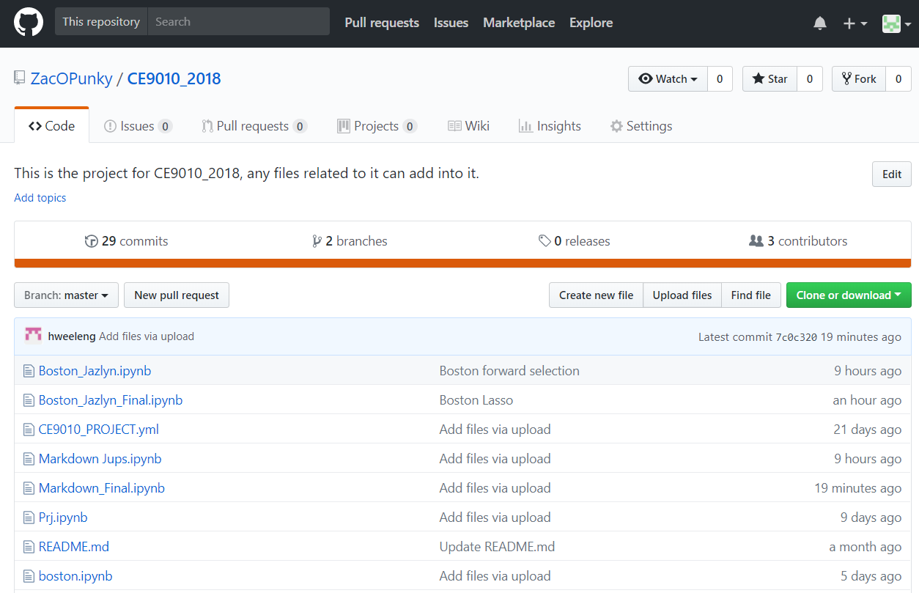
Step 7: Report results in Python Notebooks
https://github.com/ZacOPunky/CE9010_2018

